Slide 1
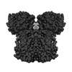
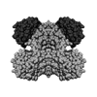
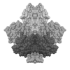
Original Images

Slide 2
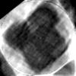
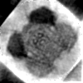
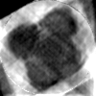
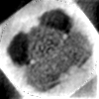
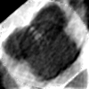
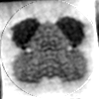
Reconstruction using DCT basis
2 classes
15 percent noise
No of projections – 20000, 25000, 30000
23.10% 29.16%
22.96% 27.55%
19.14% 23.39%

Slide 3
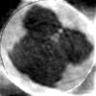
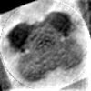
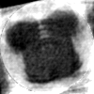
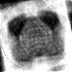
Reconstruction using DCT basis
2 classes
15, 20, 25 percent noise
No of projections – 30000
19.14% 23.39%
22.83% 26.04%
23.99% 27.98%

Slide 4
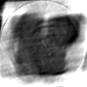
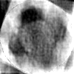
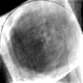
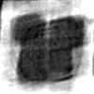
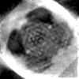
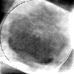
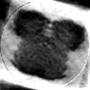
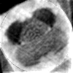
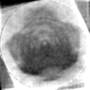
Reconstruction using DCT basis
3 classes
15 percent noise
No of projections – 20000, 25000, 30000

Slide 5
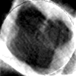
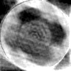
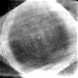
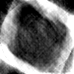
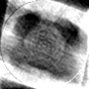
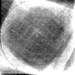
Reconstruction using DCT basis
3 classes
15, 20, 25 percent noise
No of projections –30000

Slide 6
Kernel K-means
Number of projections – 8000
Noise 10%
2 classes

Slide 7
Kernel K-means
Number of projections – 8000
Noise 10%
2 classes

Slide 8
Kernel K-means – sometimes it fails
Number of projections – 8000
Noise 20%
2 classes

Slide 9
Kernel PCA
Number of projections – 8000
Noise 10%
2 classes

Slide 10
Kernel PCA
Number of projections – 8000
Noise 10%
2 classes

